Slide 1

AEROIC ACCOUNTS
Your #1 Email Provider

Slide 2
Table of Contents
Business Model
2) Why did I choose this business model?
3) HTML & CSS Code
4) Issues/Challenges

Slide 3
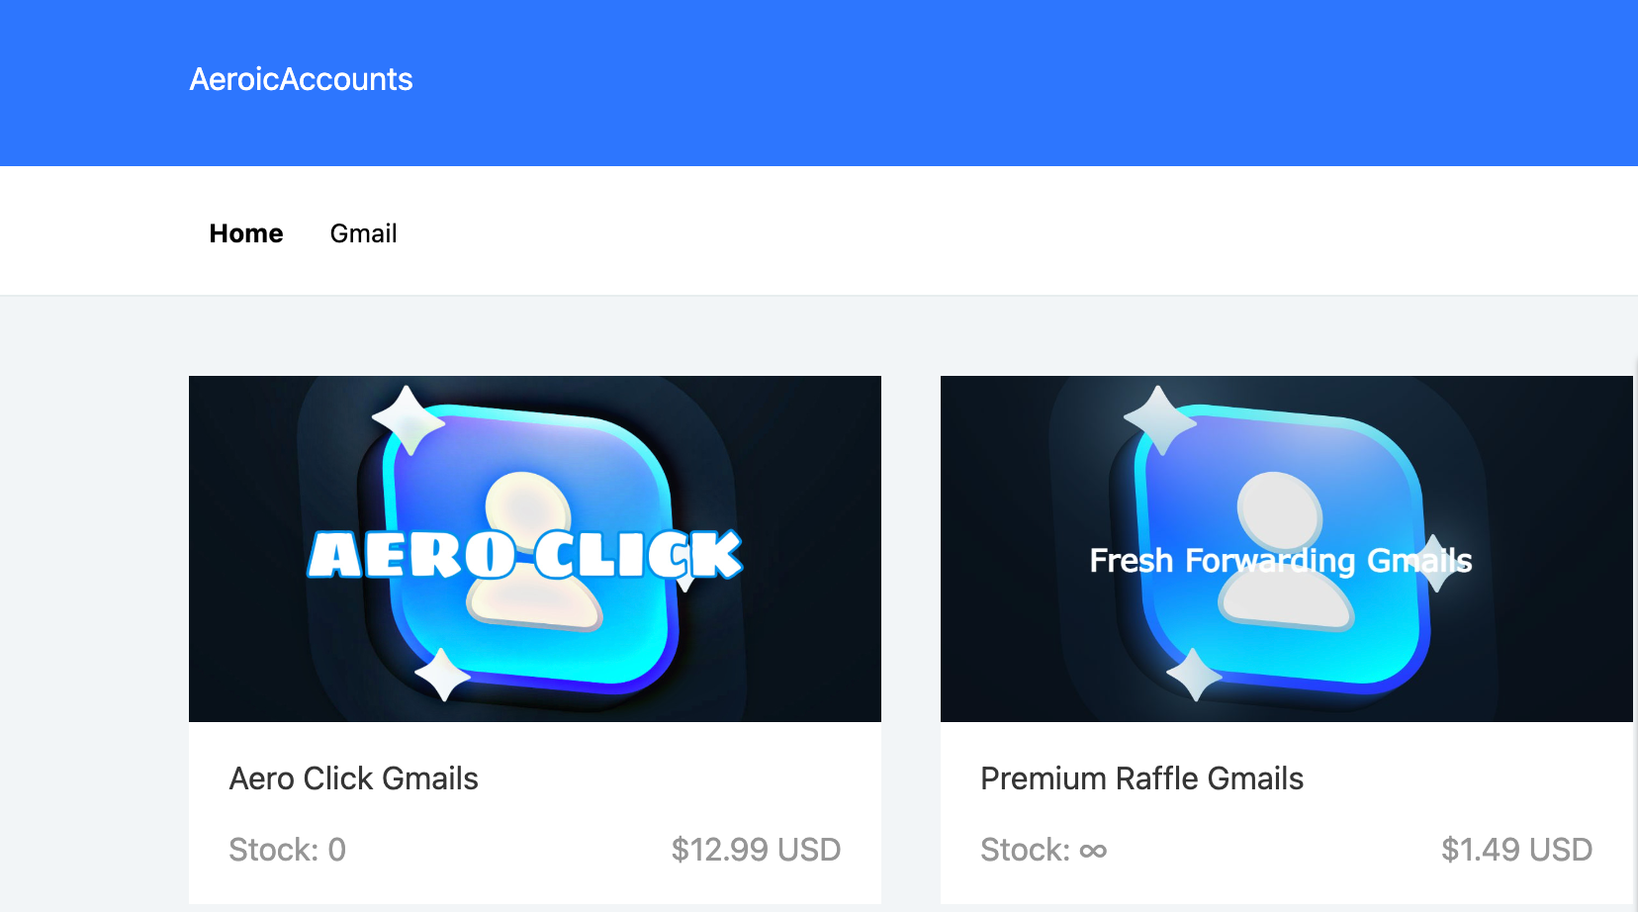
Business Model
In order to purchase any hyped item whether physical or virtual an email address is required to prove that you are a unique individual and not a robot. E.g (concert tickets, clothes, shoes, electronics and etc.)
In order to increase your odds of getting these items you may need additional email addresses or emails with a high activity/recaptcha score. By using my knowledge of intrusion detection I can provide customers with any solution they need.

Slide 4
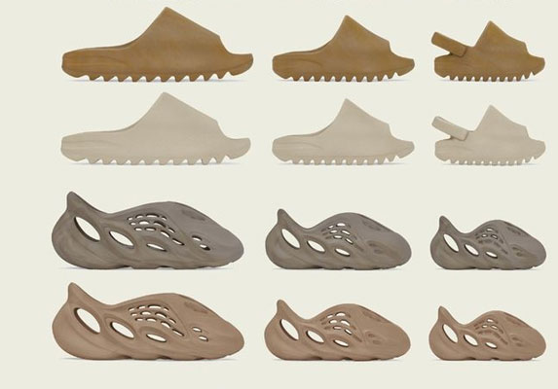
Why did I choose this business model?
During the pandemic I could not go outside so I chose to interact with my friends online and we all had the same interest, shoes, clothes, electronics and various other highly sought after items.
Once I realized there was a need for these items, I concluded that I could provide them myself or the resources needed to get them. I decided to do the latter.

Slide 5
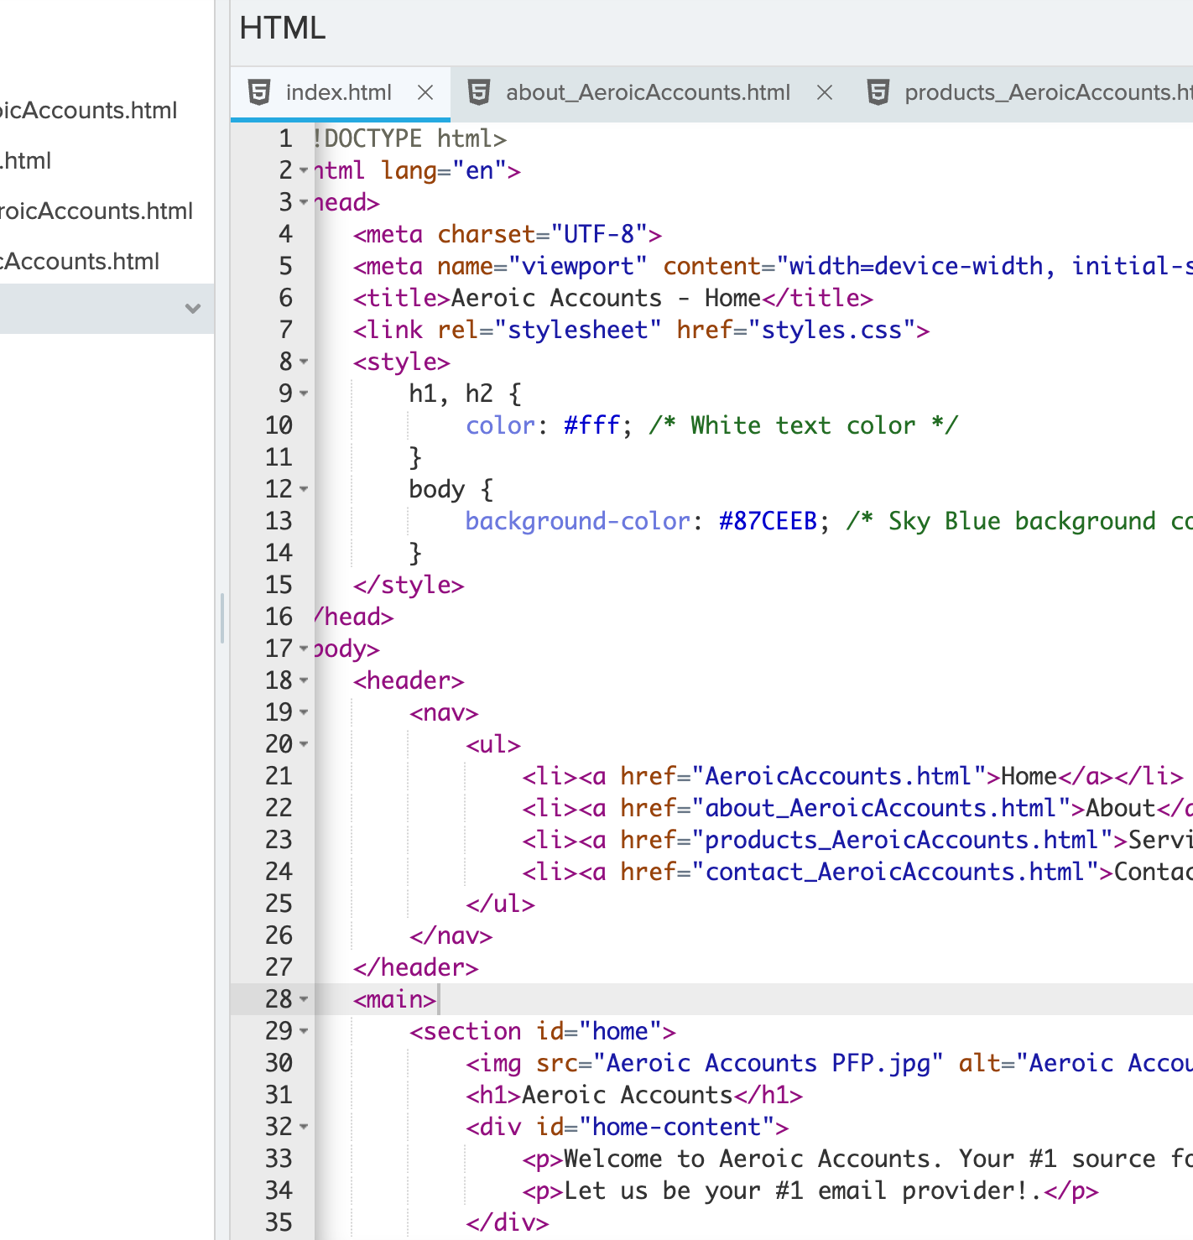
HTML & CSS CODE
I was able to use various html code to fill in the details of my business and other additional information while CSS Code was used to format and align my images

Slide 6
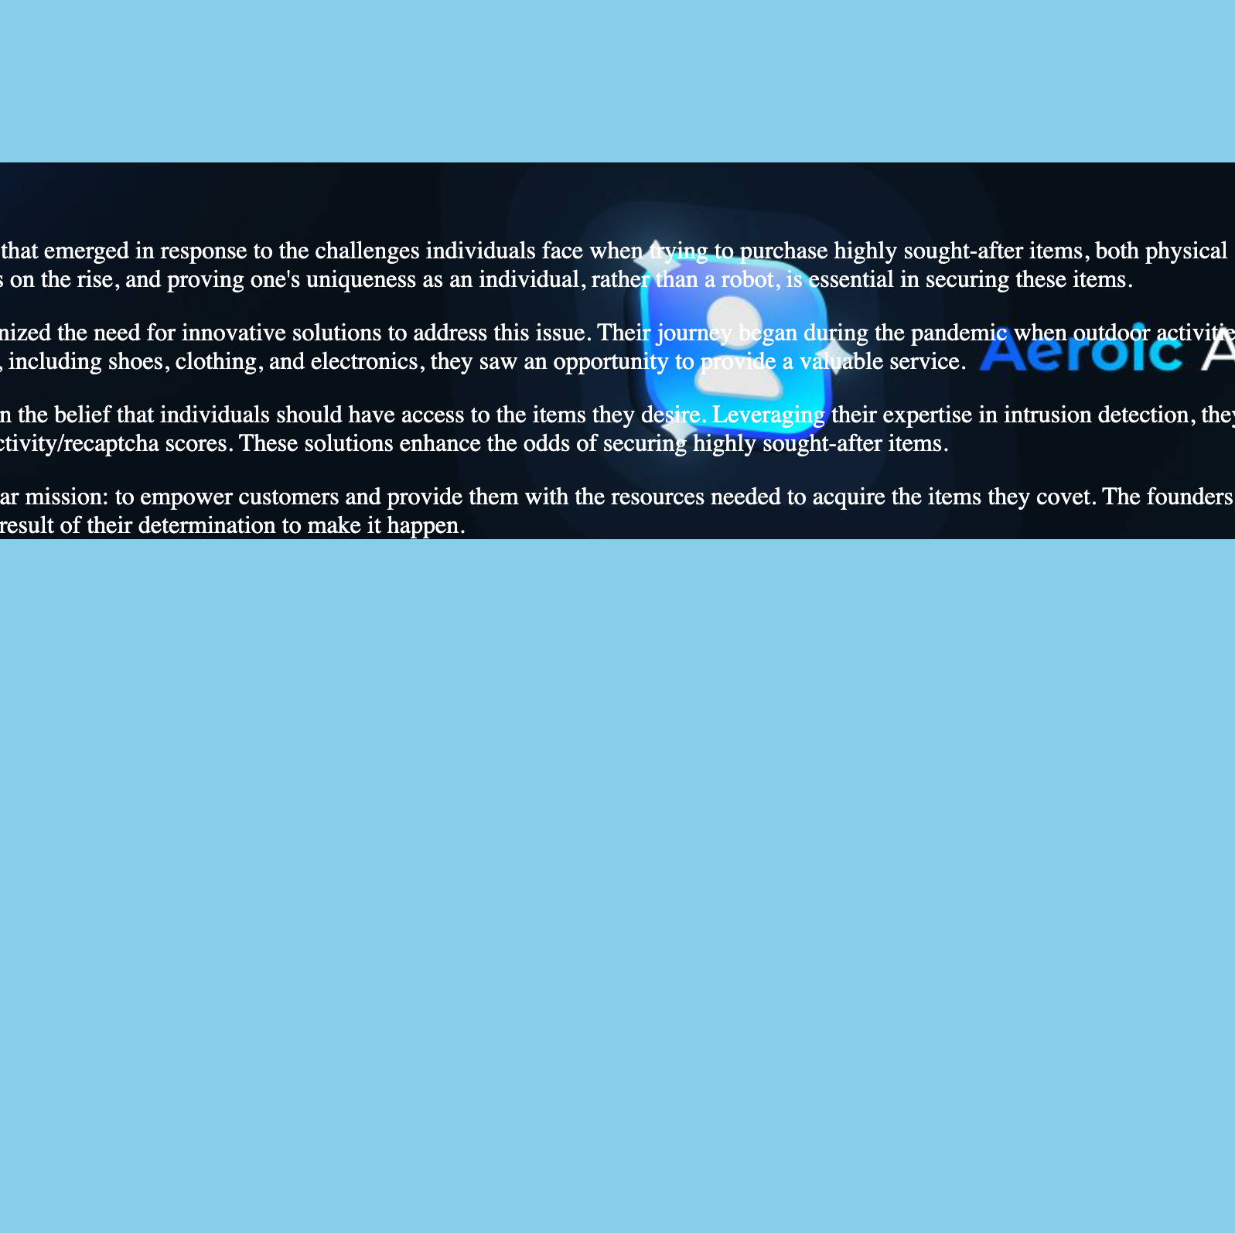
ISSUES/CHALLENGES
Overall the HTML Code was not too difficult but aligning and inserting images using CSS correctly was a problem. I had to watch various videos to find a solution.
In addition creating borders for my table was very tedious since I had never seen an example of it before. But my biggest issue was inserting the table on the same page as my other topics. When I attempted to do so it would overwrite my previous code so I created a new html file and linked the code in the file to a hyperlink as a work around.

